Slide 1
The Battle of Neighborhoods (Week 2)

Slide 2
Find Best Location to start an Ice Cream Business in Boston Area

Slide 3
Introduction
Selecting a location for a creating a new business is a key decision in running a existing business. Business decision makers need to be considered different factors to find right location for the business, such as financial , market and the factors that will affect their demand and increase their revenue.
This project is to assist those who are planning to open a new business such as an ice cream shop and need to find the best location for the shop in a Boston city.

Slide 4
Business Problem
Boston is a challenging city to start a new business in, since it has 23 neighborhoods with various tourist attractions.
It is paramount to evaluate factors that would impact the success of business in these 23 neighborhoods
Factors such as
Number of competitors
Demand in each neighborhood
Budget limitations related to renting or buying the place of operations

Slide 5
Data
Extract information about the neighborhoods of Boston along with the median one-bedroom rent price (as an estimate of the renting price of the shop) of each neighborhood using the following website and BeautifulSoup website scraping library: https://bostonpads.com/2019-boston-apartment-rental-market-report/
Transform the data into pandas dataframe
Use GeoPy Python package to get the latitude and the longitude coordinates of all the neighborhoods of Boston
Map the neighborhoods using Folium Python library
Use Foursquare API to get information about some venues around these neighborhoods

Slide 6
Foursquare API - Neighborhood
Looking for a group of venues of each of the neighborhood:
Movie Theater, Playground, Park, Garden, Water Park, General Entertainment, Stadium, Amphitheater, Aquarium, Street Art, Beach, Recreation Center, Pedestrian Plaza venues).
These venues are places that many people usually visit them for entertainment and hence we will have good demand for ice cream around them.
Looking for Ice cream shops of each of the neighborhoods.
To get an understanding of the competitors in each neighborhood. In total, 112 Ice Cream Shop were found in Boston Area.

Slide 7
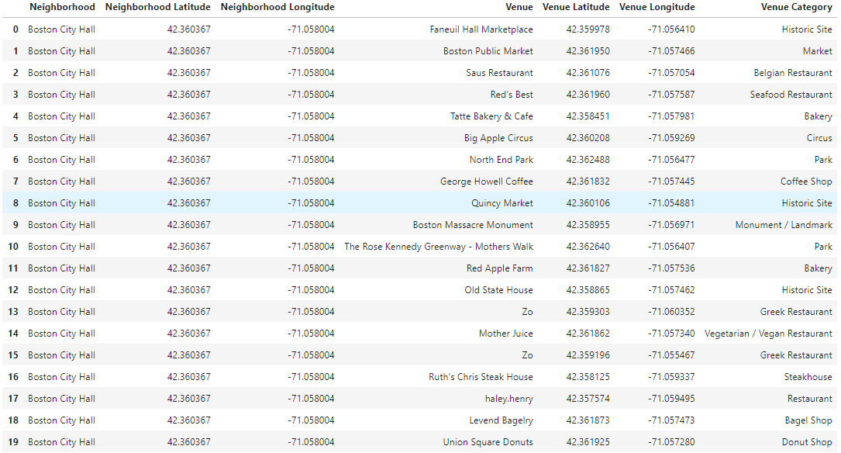
Venues Rederived by Foursquare

Slide 8
Methodology
Remove neighborhoods where the ice cream shop available already
Cluster the neighborhoods using k-means to cluster the neighborhood into 5 clusters based on the frequency of different venue categories (except ice-cream shop) around them.
Sort the neighborhoods in each cluster based on their average rent price
Select the neighborhood within the budget limits that has fewer ice-cream shop and more of other venue categories around.

Slide 9
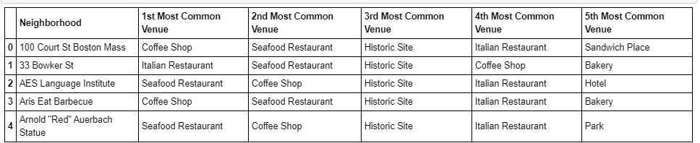
Identify Top 5 venues

Slide 10
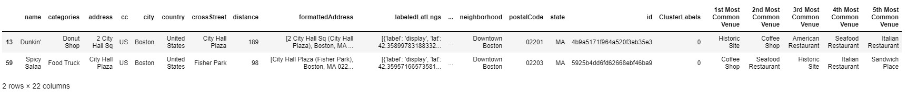
Clustering Neighbors

Slide 11
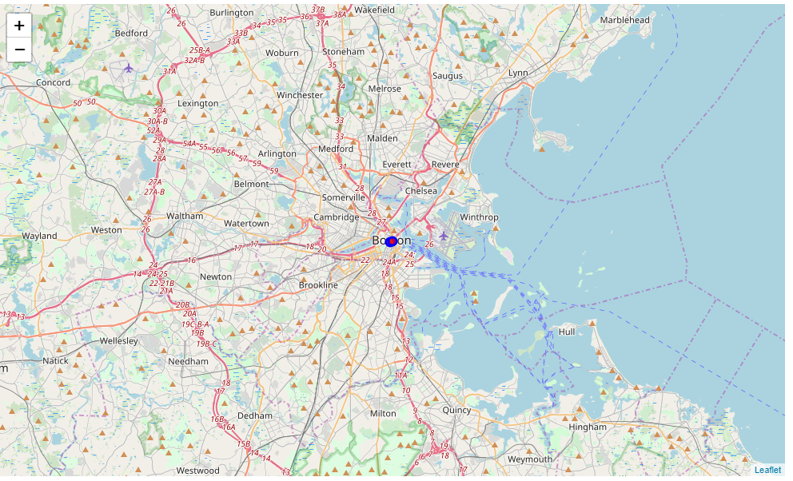
Cluster Map Folium
Based on the number of cluster (2). The map has been created and helped to identify the venue based on the criteria.

Slide 12
Results
Downtown Boston (in cluster 1) is the best neighborhood to open an ice cream shop in Boston.
Has greatest number of total venues and is expected to attract many people to visit. It has Parks, city plaza hall and no ice cream shop. However, the final decision is dependent on the budget of the client to rent the place.
According to the budget limitations of the client, we can find other neighborhoods and select the one with the greatest number of venues and a smaller number of ice cream shops around. This clustering can also help our client compare different neighborhoods to make a better decision.

Slide 13
Conclusion
Based on the analysis:
We have limited the location options to the neighborhoods of Boston, however considering more specific locations such as apartments areas can improve the accuracy of our decision.
We used the median of one bedroom rent price in each neighborhood as an estimate of the rent price.
We limited our investigation for the venues within 500 meter of the neighborhoods and changing it can affect the clusters.
Overall Good learning and understood better on a activities needs to be performed by a Data scientist.

